Slide 1
Communication Protocols
Arti & Liz

Slide 2
Communication Protocols
Bit transfer as a means of communication between different hardware devices
High voltage indicates a 1 and low voltage indicates a 0
Considerations
Serial vs. parallel
One vs. multiple bits sent at a time
Synchronicity
Synchronized clocks between transmitting and receiving device
Master-slave relationships
Master device has control over slave devices
Data Direction
Half-duplex: both devices can communicate with each other but not simultaneously
Full-duplex: both devices can communicate with each other simultaneously
Notes:
Why not serial ports? (Asynchronous)
-Two systems with different clocks to communicate with each other
-Adds extra start and stop bits to help receiver sync at the start of each byte→ too much overhead
-Both sides must agree on the transmission speed

Slide 3
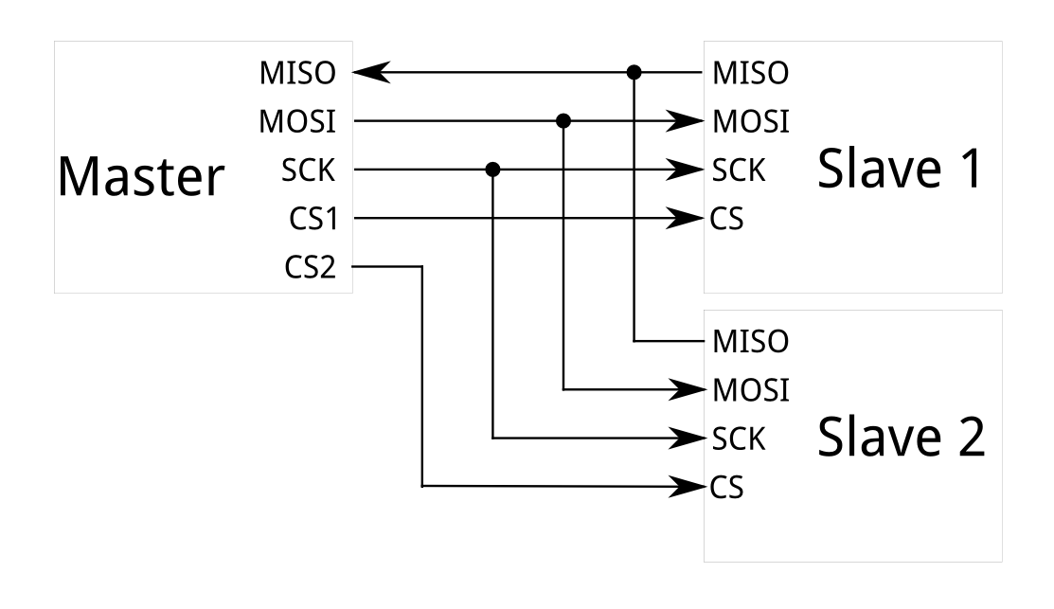
Serial Peripheral Interface (SPI)
MOSI and MISO
Master-out slave-in and master-in slave-out data lines
Full-duplex
SCLK
Clock line
Synchronous
SS
Slave select
Supports one master multiple slaves

Slide 4
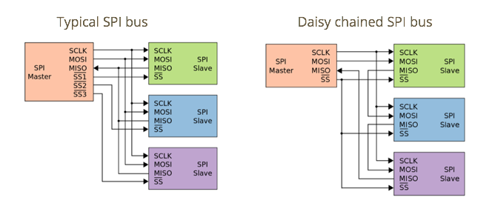
Multiple-Slave Connections

Slide 5
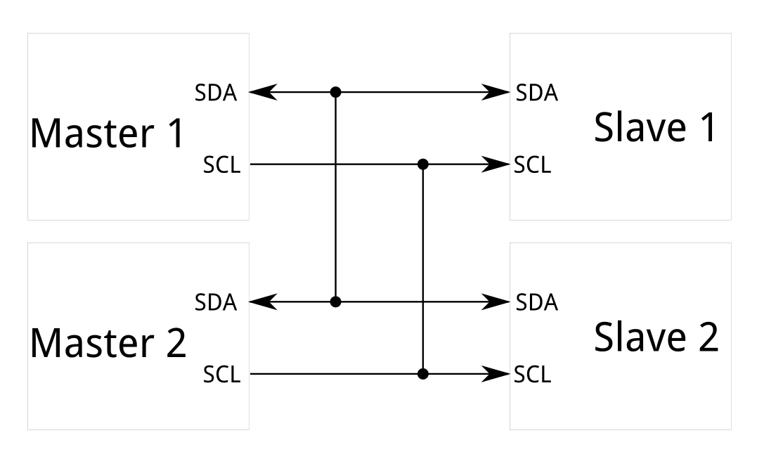
Inter-Integrated Circuit (I2C)
SDA
Single data line
Half-duplex
Supports multiple masters multiple slaves
SCL
Clock line
Synchronous
Notes:
Why not SPI?? (Requires more signal lines; undesirable when there are multiple slaves; Requires separate SS lines to each slave; Only allows one master)
Interview question: (multiple masters) before a master initiates a communication, how does it know if the line is busy?

Slide 6
Code Along!

Slide 7
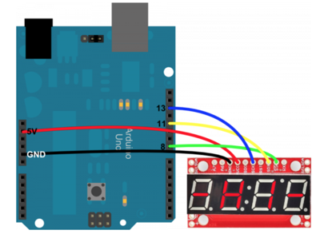
7 segment display counter using SPI
Arduino -------------- 7-Segment
5V -------------------- VCC
GND ------------------ GND
8 -------------------- SS
11 -------------------- SDI
13 -------------------- SCK

Slide 8
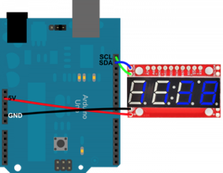
7 segment display counter using I2C
Arduino 7-Segment
5v ------------------------- VCC
GND --------------------- GND
SCL (A5: pin 19) ----- SCL
SDA (A4: pin 18) ----- SDA

